Slide 1

CRUISE CONTROL
PRESENTED BY:-
JAYANT VERMA
KIRAN KUMAR C.R
BHAVANA B.
MB POORNIMA
SAMPADA GHULE

Slide 2
CONTENTS
Introduction
Requirement
Design
System block diagram
Hardware block diagram
Functional block diagram
Sequential flowchart
Test cases

Slide 3
INTRODUCTION
Cruise control is a system, which automatically controls the speed of vehicle and maintain the distance with others vehicle.
The basic operation of cruise controller is to sense the speed of the vehicle, compare this speed of a desired reference and then accelerate or deaccelerate the car as required.

Slide 4
REQUIREMENTS
Type | Object
Heading | Cruise Control Warning LED.
Definition | Cruise control is a system, which automatically controls the speed of vehicle and maintain the distance with others vehicle.
 | CC SET
Requirement | 1. Cruise control output LED1 shall be set ON when the cruise control is SET.
Requirement | 2. Cruise control output LED1 shall be set OFF when the cruise control is RESET.
 | NRCS
Requirement | 1. LED2 shall be activated if the NRCS input message is faulty.
Requirement | 2. LED2 shall be deactivated if the NRCS input message is valid.
 | CC STATUS
Requirement | 1. If the actual speed and reference speed is equal then LED2 should be OFF.

Slide 5
REQUIREMENTS
Type | Object
Requirement | 2. If the actual speed is greater than reference speed then LED2 should be ON.
Requirement | 3. If the actual speed is less than reference speed then LED2 should be ON.

Slide 6
SYSTEM BLOCK DIAGRAM
NRCS
CAN I/P
Cruise Control
LED1
CC ON/OFF
Cruise Control
HW O/P
HW I/P
LED2
CC Status
HW O/P
CAN O/P
Vehicle acceleration speed
CC ON/OFF
NRCS Input Status (Valid/Faulty)

Slide 7
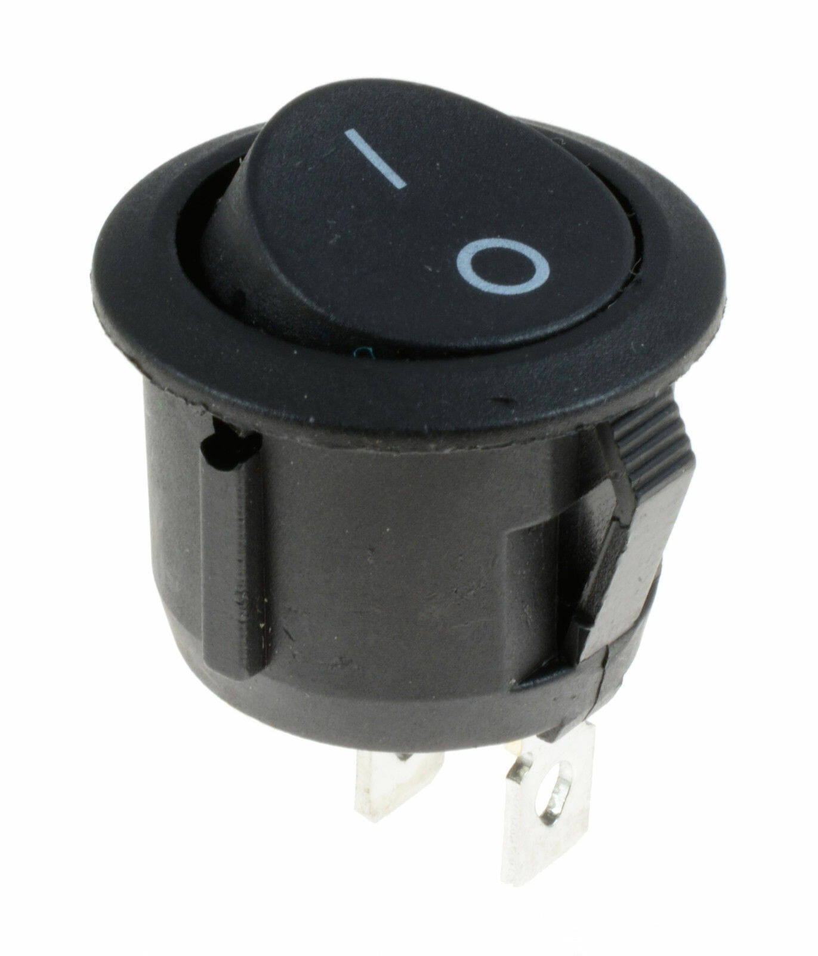

Hardware BLOCK DIAGRAM
CAN High
CAN Low
H
L
IXXAT
CAN Transceiver
H
RX
TX
GND
VCC
L
MICROCONTROLER
RB3
RB2
GND
VCC
CC ON/OFF
SWITCH
CC status
Power Supply 5V

Slide 8
Functional BLOCK DIAGRAM
System_initialization()
CAN_initialization
1
2
Switch()
3
CC_main() {
system_initialization()
CAN_initialization()
CC()
CC_status()
}
0
transmit_speed()
CC ()
7
4
actual_speed()
Interrupt() ISR1()
6
eeprom_write()
recieve()
5
reference_speed()

Slide 9
SEQUIENTIAL FLOW CHART
SYSTEM INIT
Start
Enable global interrupt GIE=1
Enable the peripheral interrupt PEIE=1
Stop

Slide 10
CAN INITIALIZATION
Start
Receive RB3=Enable
Transmit RB2=Disable
Set Configuration Mode
CANCON=0x80;
Can status CANSTAT !=0x08;
Set baud rate
BRGCON1=0xC1;
BRGCON2=0xAE;
BRGCON3=0x45;
RXBC0Nbits.RXMO=1; RXBC0Nbits.RXM1=1 ;
CAN I/O CONTROL REGISTER CIOCON=0x20;
Set to Normal Mode
CANCON=0x00;
Stop

Slide 11
Start
TRANSMIT
Standard data frame identifier is 0x75
Standard identifier high
TXB0SIDH=0X0E;
standard identifier low
TXB0SIDL=0XA0;
Set Data length code TXB0DLC=0X08;
Set the request sending msgTXB0CON=0X08;
Stop

Slide 12

Interrupt() ISR1()
Start
Receive_1=received_speed()
If(actual _ speed==reference _speed)
True
CC OFF
False
If(actual _ speed<reference _speed)
True
CC ON
False
If(actual _
Speed>reference
_speed)
True
CC ON
Stop

Slide 13
Start
RECEIVED SPEED
Request normal mode CANCON=0x0C
Store the receive buffer value to arrays, msg[0]=RXB0D0
msg[1]=RXB0D1
.
.
.
msg[7]=RXB0D8
Store the DLC value
msg[8]=RXB0DLC
Store the receive identifier high & low value to array msg[9]=RXB0SIDL;
msg[10] =RXB0SIDH;
Receive buffer is open to receive a new msg RXB0CONbits.RXB0FUL=0;
Can set to normal mode CANCON=0X00;
Stop

Slide 14
EEPROM_WRITE
start
Storing data and address
EEDATA=data
EEADR=address
EECON2=0x55
EECON2=0xAA
Set write bit EECON1bits.WR=1
Write enable bit EECON1bits.WREN=1
Stop

Slide 15
SWITCH
Start
Initialize PORTB=0;
SW ON
True
Actual speed is transmit & LED should ON
False
SW OFF
True
LED OFF
Stop

Slide 16


Main()
Start
System_Initialization()
CAN _initialization()
Transmit_Speed()
Received_Speed()
EEPROM_Write()
Stop

Slide 17
TEST CASES
Test Case ID | Heading | Precondition | Expected Result | Obtained result
TC_CC_001 | Speed | speed should be set | Speed set | Speed set
TC_CC_002 | Acceleration | Acceleration speed should receive | Speed received | Speed received
TC_CC_003 | CC status | CC should be set ON | CC ON | CC ON
TC_CC_004 | NRCS | NRCS status | Led should ON/OFF | Led should ON/OFF

Slide 18
DATA BASE
Node description | Node name | Msg ID | Cyclic time(ms) | Msg size | Byte 7 | Byte 6 | Byte 5 | Byte 4 | Byte 3 | Byte 2 | Byte 1 | Byte 0
Cruise control | CC | 0x75 | 500 | 8 | Warning lamp activated/faulty/not activated (bit3-bit 4) | NRCS I/P: valid/faulty(bit0) |  | CC status bit0:bit1-ON/OFF/faulty |  | Acceleration ON/OFF | Speed byte1 | Speed byte0
Near range camera sensor | NRCS | 0x75 | 500 | 8 | Bit0:set indicates faulty |  |  | Speed byte1 | Speed byte0

Slide 19
THANK YOU

